Slide 1


How to Enhance that UI with PCF
Rami Mounla
Solution Architect | Power Platform | DXC NZ

Slide 2
You, Me, and the Power Platform

Slide 3
What is the Power Platform Component Framework?

Slide 4
Examples

Slide 5
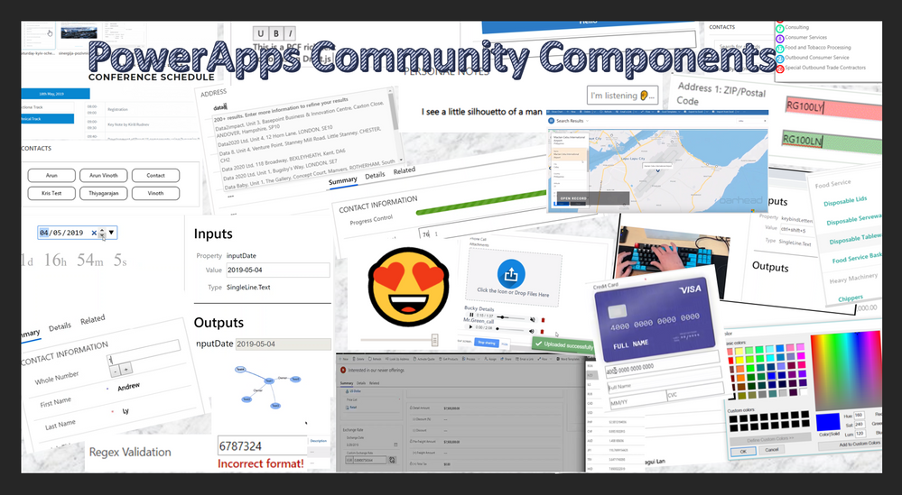

Slide 6
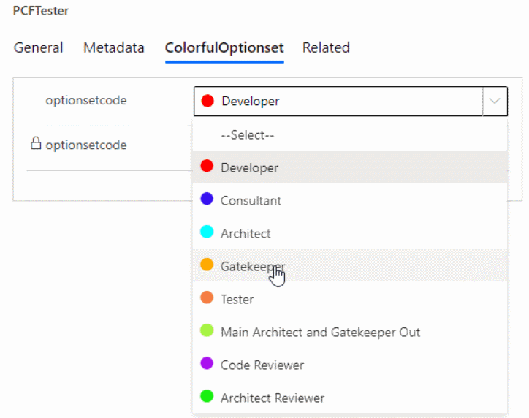

Slide 7
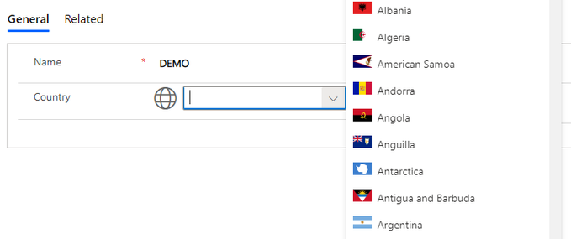

Slide 8
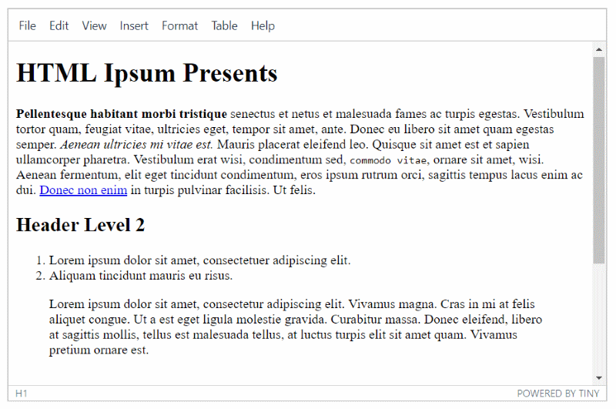

Slide 9
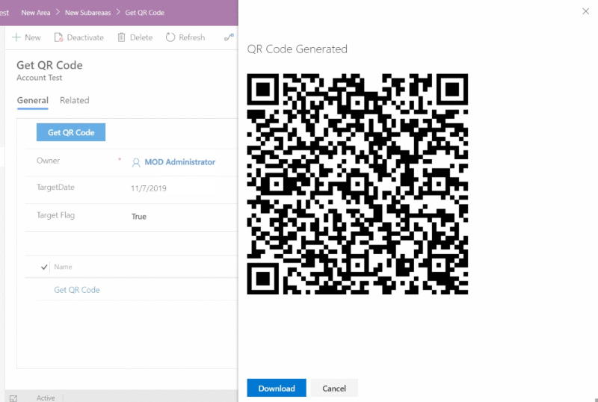

Slide 10
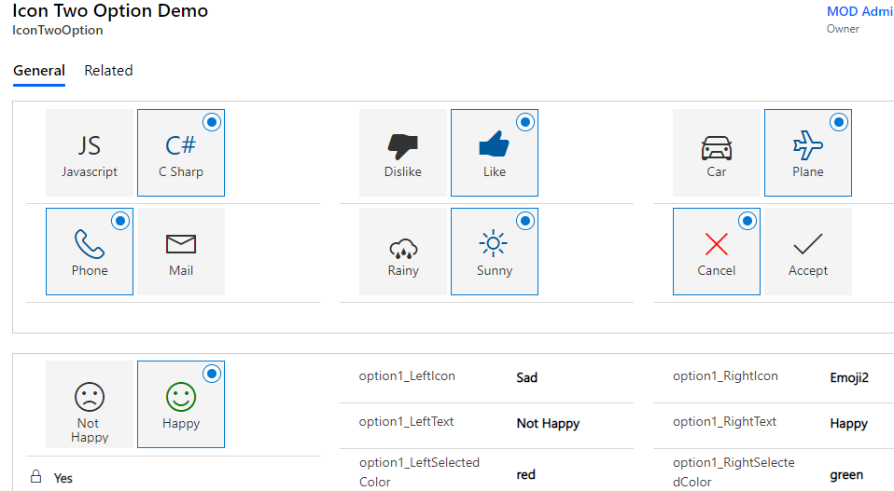

Slide 11
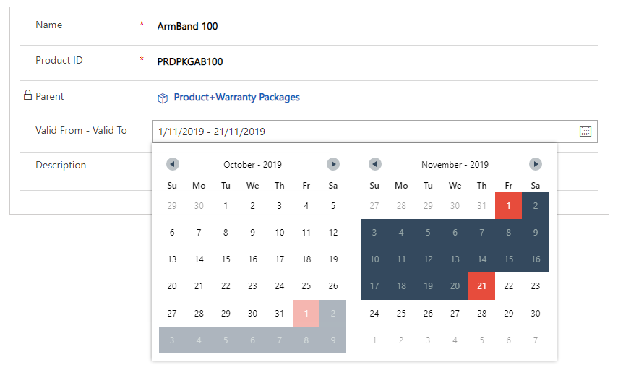

Slide 12
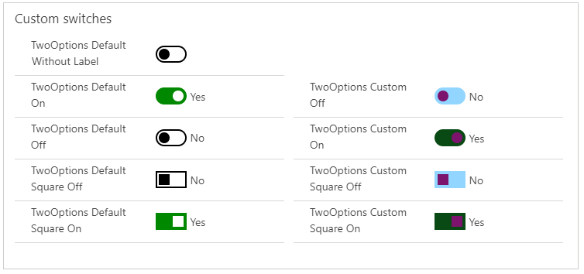

Slide 13
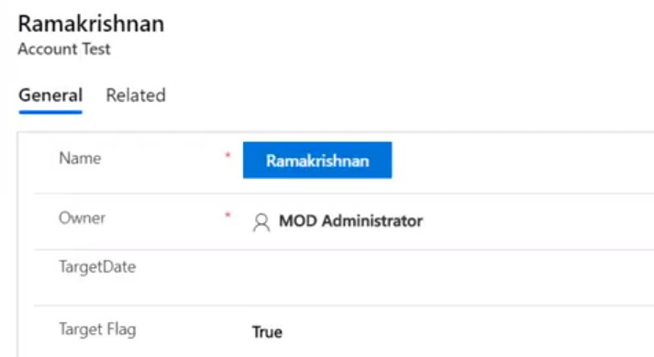

Slide 14
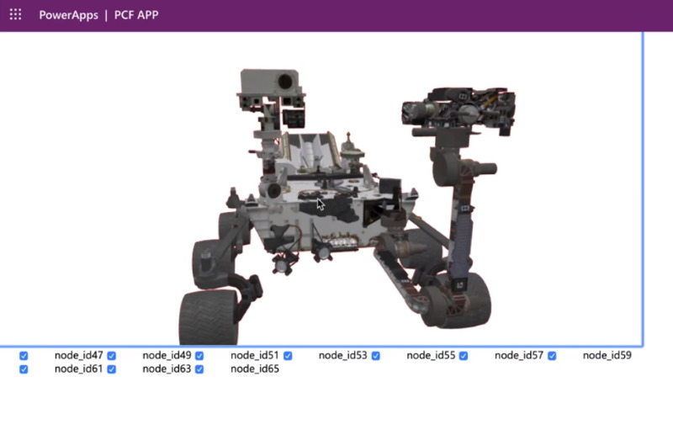

Slide 15
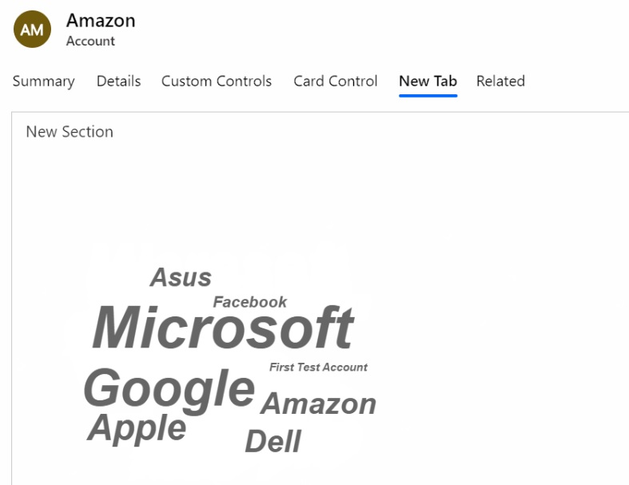

Slide 16
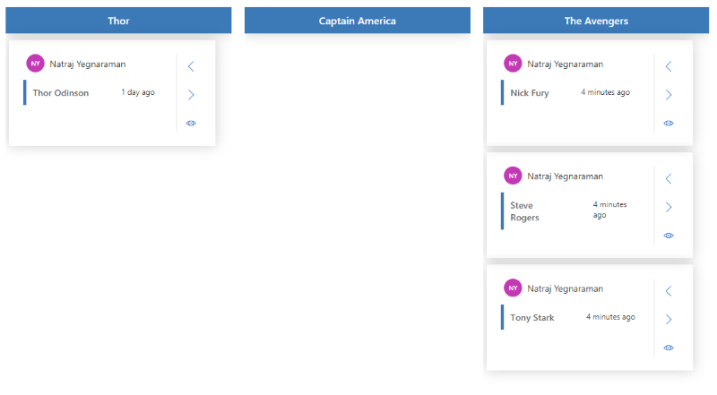

Slide 17
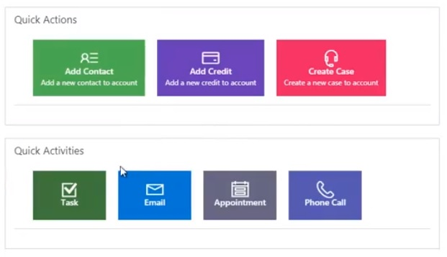

Slide 18
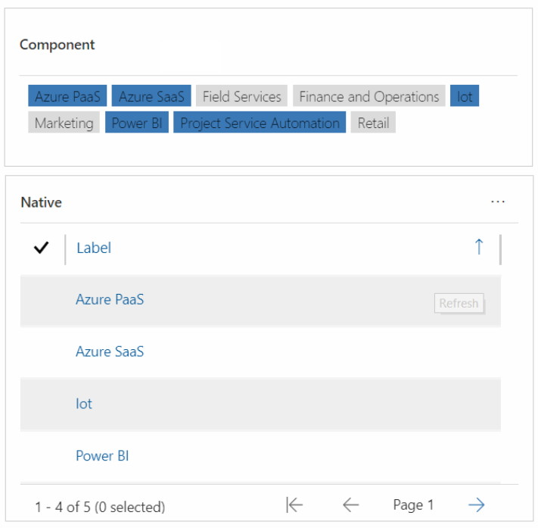

Slide 19
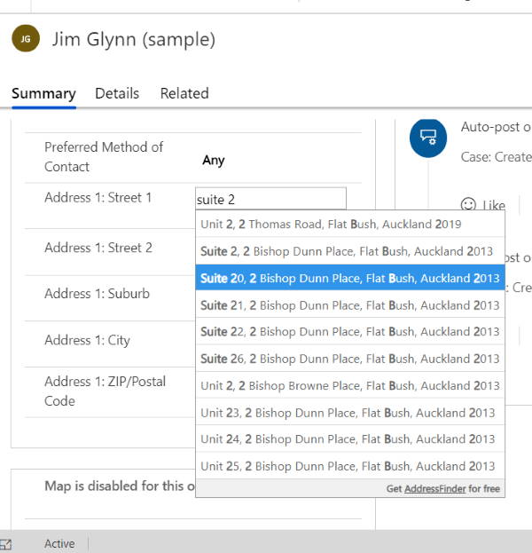

Slide 20
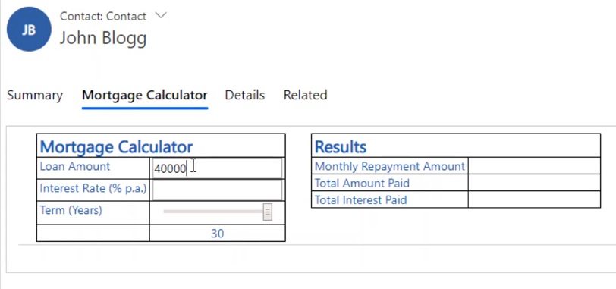

Slide 21
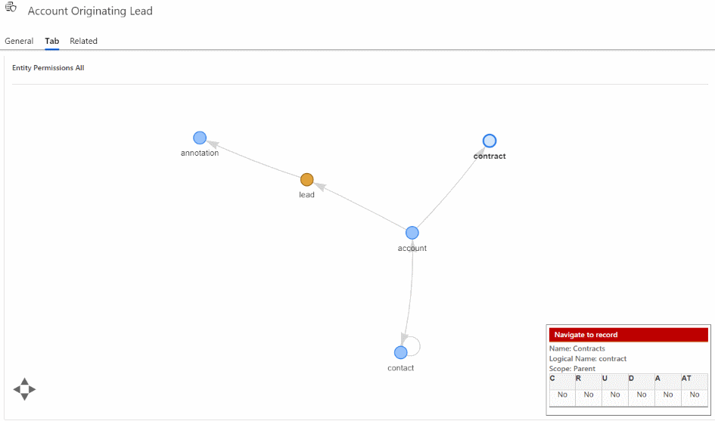

Slide 22
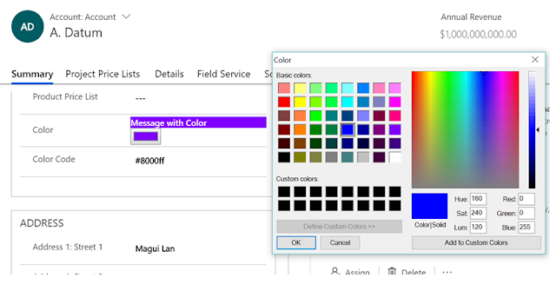

Slide 23
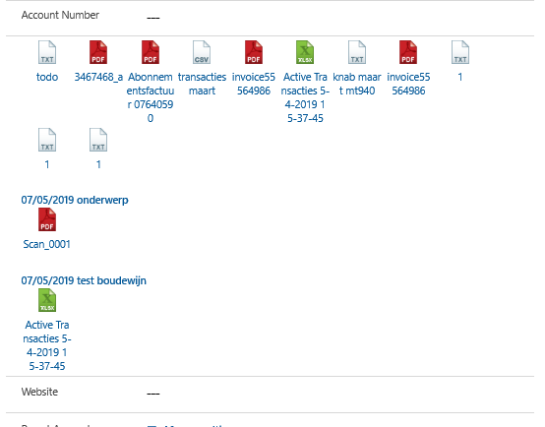

Slide 24
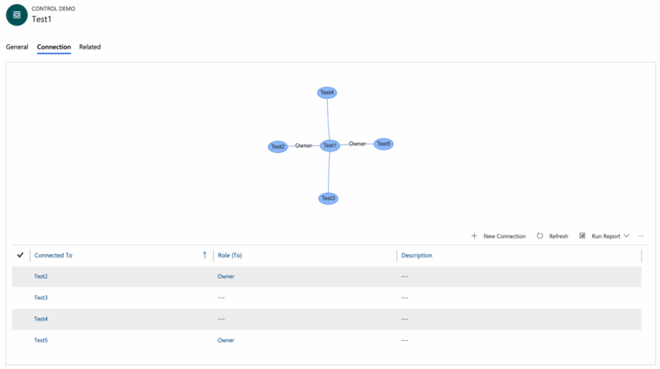

Slide 25
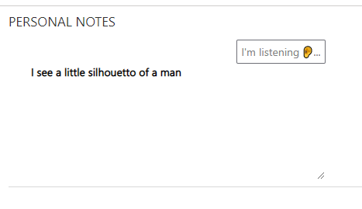

Slide 26
NZ specific ones

Slide 27
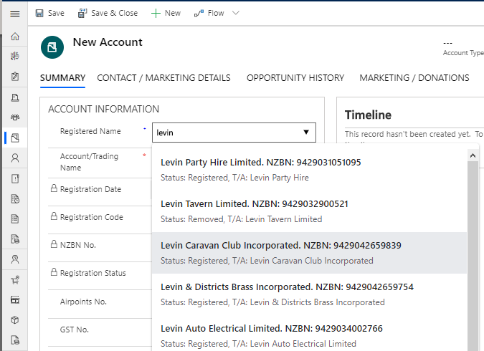

Slide 29
Field v Data Sets

Slide 30
Learning Curve
What you need to know

Slide 31
Technologies
NPM
TypeScript
HTML + CSS

Slide 32


Slide 33
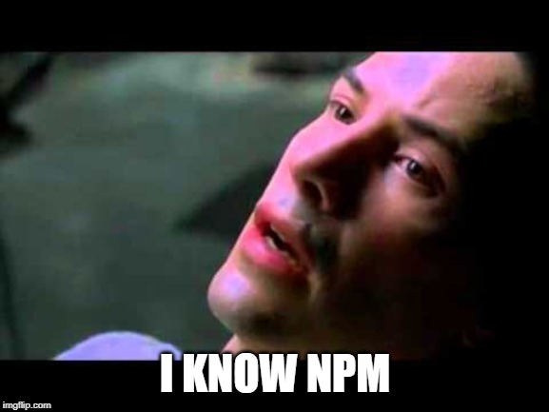

Slide 35
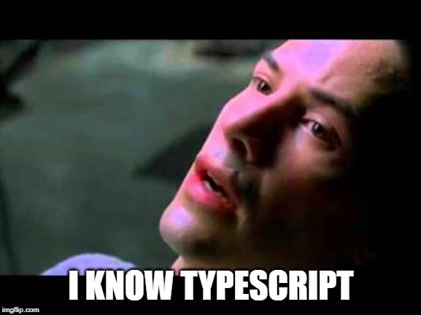

Slide 36
The 8 Commands
That you need to know

Slide 37
Cheat Sheet Create Control
pac pcf init --namespace XrmEnterprise --name CalendarView --template dataset
pac pcf init --namespace XrmEnterprise --name Tile --template field
npm install
npm run build
npm start

Slide 38
Cheat Sheet Package Control
pac solution init --publisher-name XrmEnterprise --publisher-prefix xe
pac solution add-reference --path ..\CalendarView
msbuild /t:restore
msbuild

Slide 39
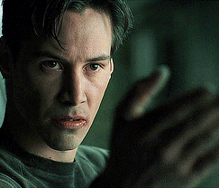

Slide 40
Example: Field

Slide 41
Example: Data Set

Slide 42


Slide 43
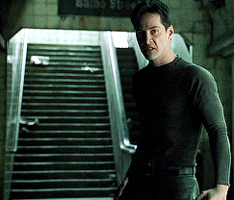

Slide 44


Slide 45
Useful links
Microsoft Documentation
https://docs.microsoft.com/en-us/powerapps/developer/component-framework/overview
Rami’s Samples
https://github.com/ramimounla

Slide 46

Thank you

